Slide 1


TITLE / SIMPLE
Our plan for
the next year
Where we will invest, and what we need to prove.
EXAMPLE / Replace with your content
M04

Slide 2
EXECUTIVE SUMMARY / COMPLEX
Mid-market has the shortest payback
SEGMENT EVIDENCE
PAYBACK / MONTHS
Measure | Small | Mid | Large
Annual value | $12K | $36K | $96K
Win rate | 18% | 32% | 15%
Sales cycle | 31 days | 68 days | 164 days
Closed accounts | 28 | 20 | 4
DECISION
Focus the next sales hires on mid-market accounts.
EXAMPLE / Replace with your content
M12

Slide 3
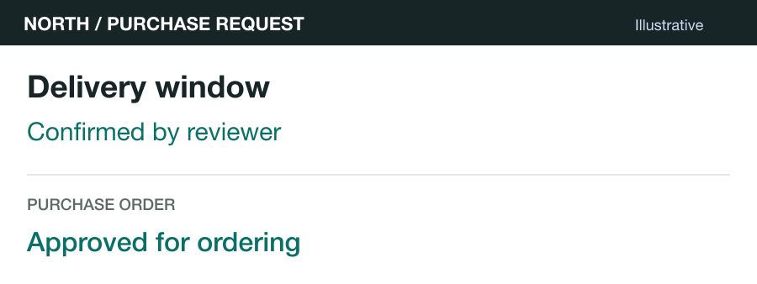
PRODUCT / SIMPLE
The purchase brief
CUSTOMER OUTPUT
A decision with
its sources
The reviewer can check the
delivery date and approve the
order.
EXAMPLE / Replace with your content
M19

